Slide 1
Welcome
Have a great evening
Pray that technology works
Please mute your microphone
Only those registered for tonight will be admitted

Slide 2
Pastoral Conversations
Remembering in a Covid Climate

Slide 3
Menu
Welcome
Outline
Prayer Chat
Ideas Chat
Resources Chat
Prayer

Slide 4

Calm Me Lord
(Margaret Rizza)

Slide 5
Mark 4:35-41
With the coming of evening that same day, Jesus said to his disciples:
"Let us cross over to the other side."
And leaving the crowd behind they took him, just as he was, in the boat; and there were other boats with him.
Then it began to blow a gale and the waves were breaking into the boat so that it was almost swamped.
But he was in the stern, his head on the cushion, asleep.

Slide 6
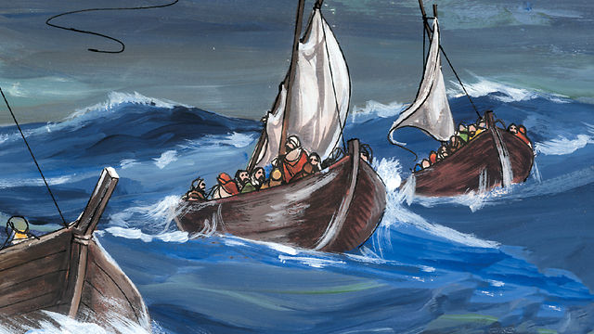

Slide 7
From Psalm 38(37)
All my frame burns with fever;
all my body is sick.
Spent and utterly crushed,
I cry aloud in anguish of heart.
My heart throbs, my strength is spent;
the very light has gone from my eyes.

Slide 8
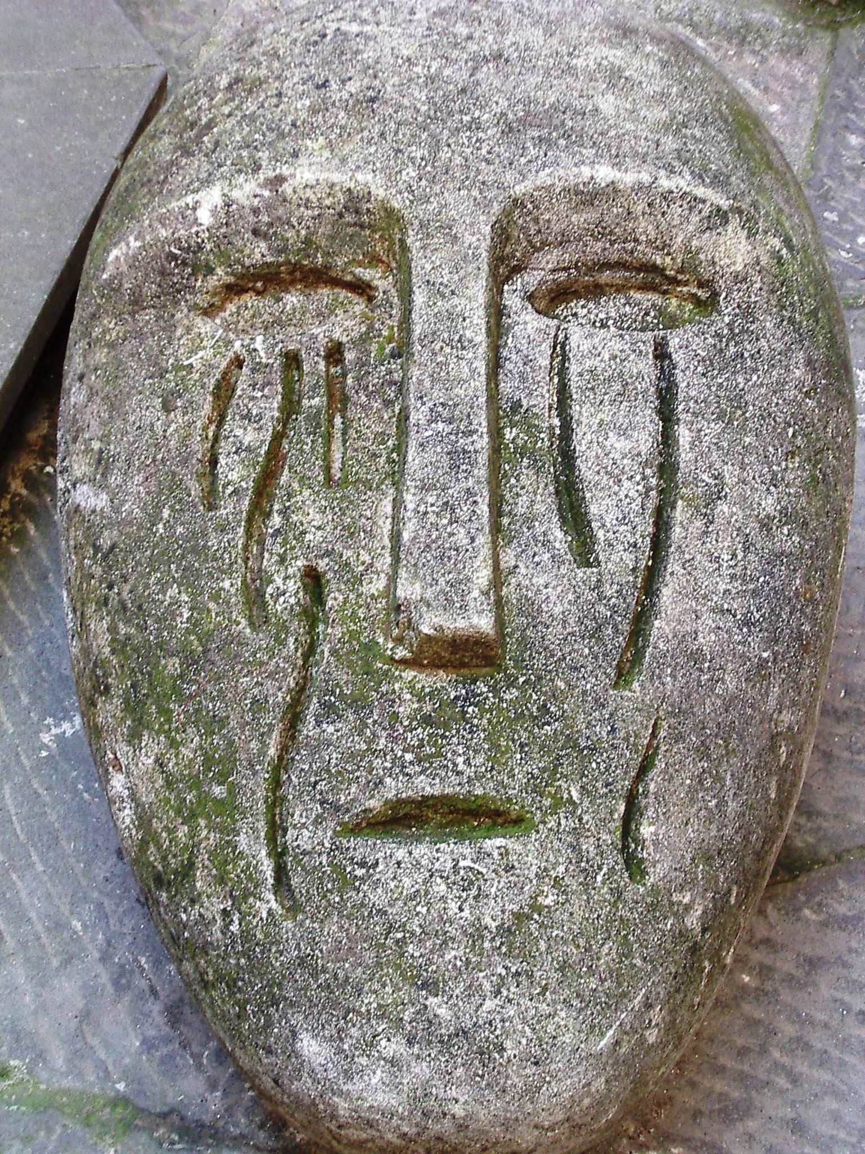

Slide 9
From Psalm 38(37)
My friends avoid me like a leper;
those closest to me stand afar off.
O Lord, do not forsake me!
My God, do not stay afar off!
Make haste and come to my help
Lord, my God, my saviour!

Slide 10
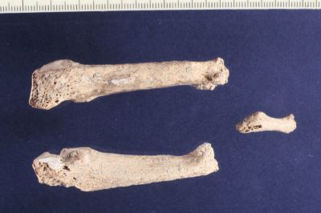

Slide 11
Romans 8:31b-39
With God on our side who can be against us?
Since God did not spare his own Son, but gave him up to benefit us all, we may be certain, after such a gift, that he will not refuse anything he can give.
Jesus not only died for us - he rose from the dead, and there at God's right hand he stands and pleads for us.

Slide 12


Slide 13
Romans 8:31b-39
Nothing therefore can come between us and the love of Christ, even if we are troubled or worried, or being persecuted, or lacking food or clothes, or being threatened or even attacked.
These are the trials through which we triumph, by the power of him who loved us.

Slide 14


Slide 15
Mark 4:40-41
They woke him and said to him, "Master, do you not care? We are going down!"
And he woke up and rebuked the wind and said to the sea,
"Quiet now! Be calm!"
And the wind dropped, and all was calm again.

Slide 16
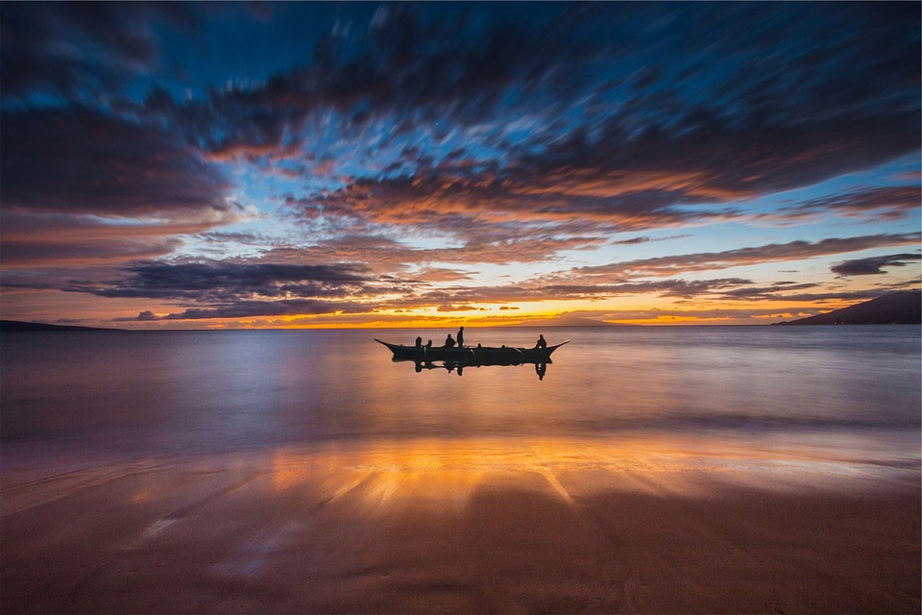

Slide 17

Chat Space

Slide 18
Chat Space
What can we do to share the Word on webcam
Will we have live music?
What about images?

Slide 19
Brother Roger of Taizé
‘Trust in the resurrection
enables us to realise
that a communion between believers
is not interrupted by death.
In simplicity of heart,
we can ask those we love
and have gone before us into eternity’s life:
“Pray for me; pray with me.”
During their life on earth,
their prayer supported us.
After their death,
how could we stop relying on them?’

Slide 20

Some Fresh Ideas?

Slide 21
Chat Space

Slide 22
Some Possible Questions
What will a remembrance service on your parish webcam look like?
What will people see?
What will they hear? Use of different voices -

Slide 23
A reflection based on Colossians 1: 17b-20
St Paul wrote with great conviction:
“In Christ Jesus all things hold together.”
So when I feel as though things are falling apart
because of the rawness of grief
or I feel guilty because I didn’t remember them today.
Or I wonder: what will happen to all these precious memories
when I forget?
I trust that in Jesus all things hold together.
And I can trust that the love of God, which has overcome all things,
will hold us together again.

Slide 24
Resources
www.litmus.dublindiocese.ie
Funeral Ministry
  Resources books
  Prayer resources
Remembrance Services
  2006 – 2019
  Texts, music etc.

Slide 25
Chat Space

Slide 26
Chat Space
Any further thoughts about resources

Slide 27
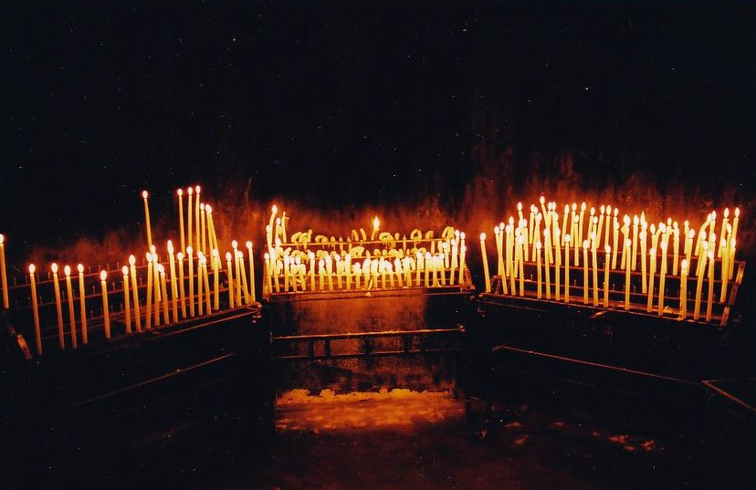
Image

Slide 28
Intercessions
Intro: Our God is Lord of the living and of the dead. We are all in God’s hands. With the trusting of faith then, we present our intentions:
Let us pray for all our parishioners who have died this past year whom we remember this evening by name before the Lord. May the tender mercy of our God grant them unending light and peace. Lord hear us…

Slide 29
We pray for families who, because of COVID restrictions, could not honour their deceased loved ones as fully as they would have liked, who were deprived too of our physical presence and support. May we continue to reach out to them. May the Risen Christ sustain them. Lord hear us…

Slide 30
We pray for all who mourn and grieve and live with the pain and ache of separation. May faces of compassion and listening ears transfigure their burden. May the Holy Spirit be their strength and consolation. Lord hear us…

Slide 31
Conclusion: We lift up all these intentions with the unspoken sighs of our hearts as we pray: Our Father…

Slide 32
Conclusion
May the love of God
and the peace of the Lord Jesus Christ
bless and console us
and gently wipe every tear from our eyes:
In the name of the Father and of the Son
and of the Holy Spirit. All: Amen.

Slide 33
Next Step
Grainne will send link
Chat with your own team
Check your email for updates
Stay safe and keep the calm

Slide 34
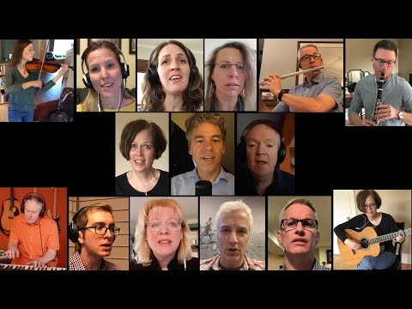
Shelter Me
(Michael Joncas)

